Slide 1

SUMMER INTERNSHIP 2015
Project FINAL Report

Slide 2
CONTENT
INTRODUCTION
PROJECT “WHEN FISH GO HOME”
DEVELOPMENT STRATEGY
DISCUSSION

Slide 3
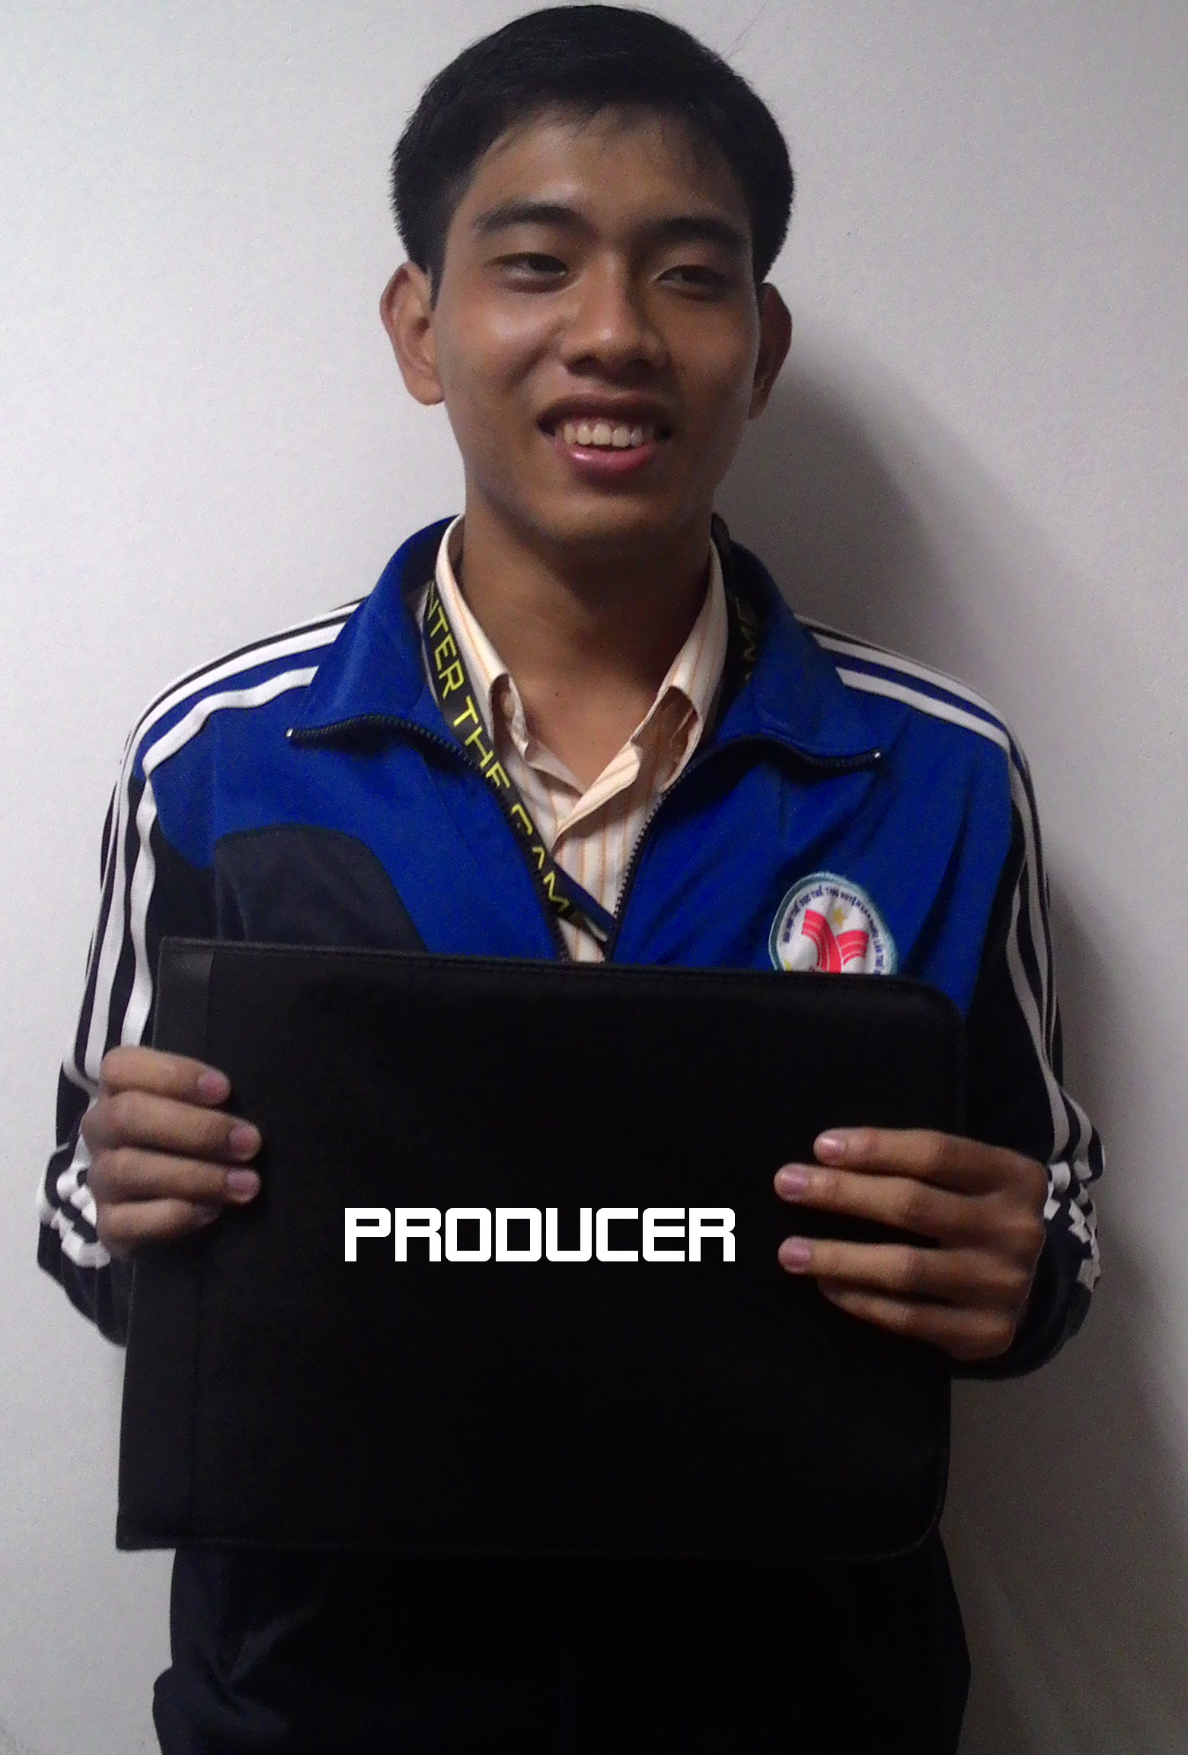



THUYEN NGUYEN
Vinh Tran
HUNG DOAN Viet
NAM DO Thanh
THANG NGUYEN Toan
INTRODUCTION

Slide 4



Slide 5
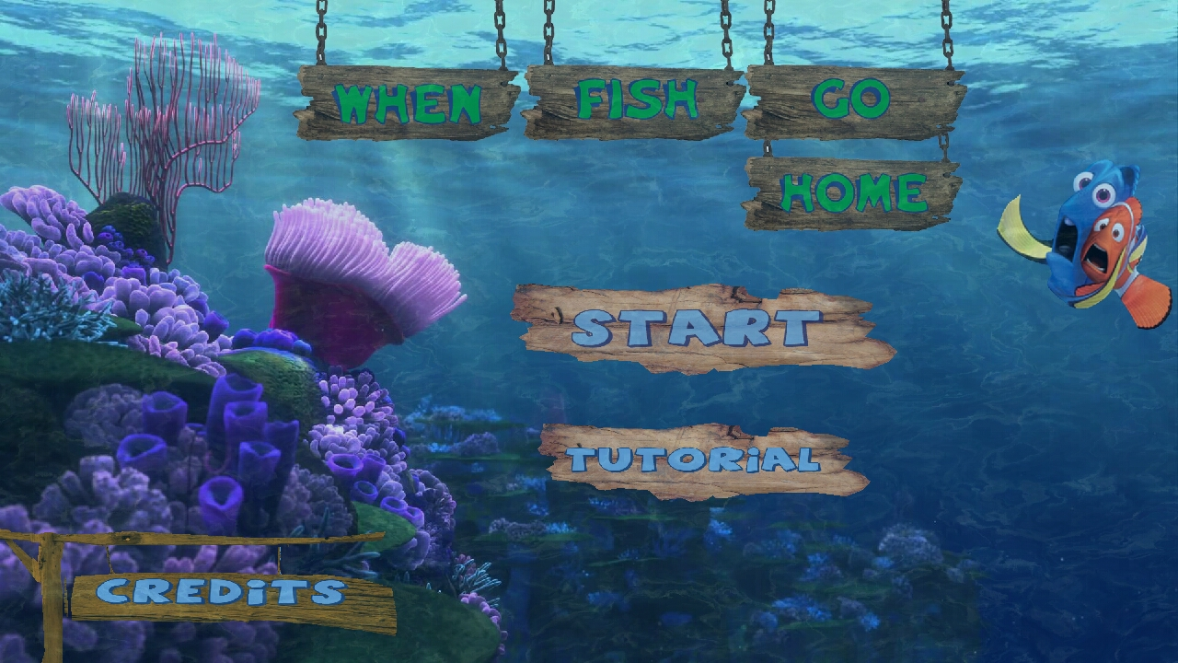
and ENTER OUR GAME

Slide 6

GAME DESIGN
CODING
GRAPHICS
&
SOUNDS
QUALITY
ASSURANCE
WHEN FISH GO HOME

Slide 7
GAME DESIGN

Slide 8
Story

Slide 9
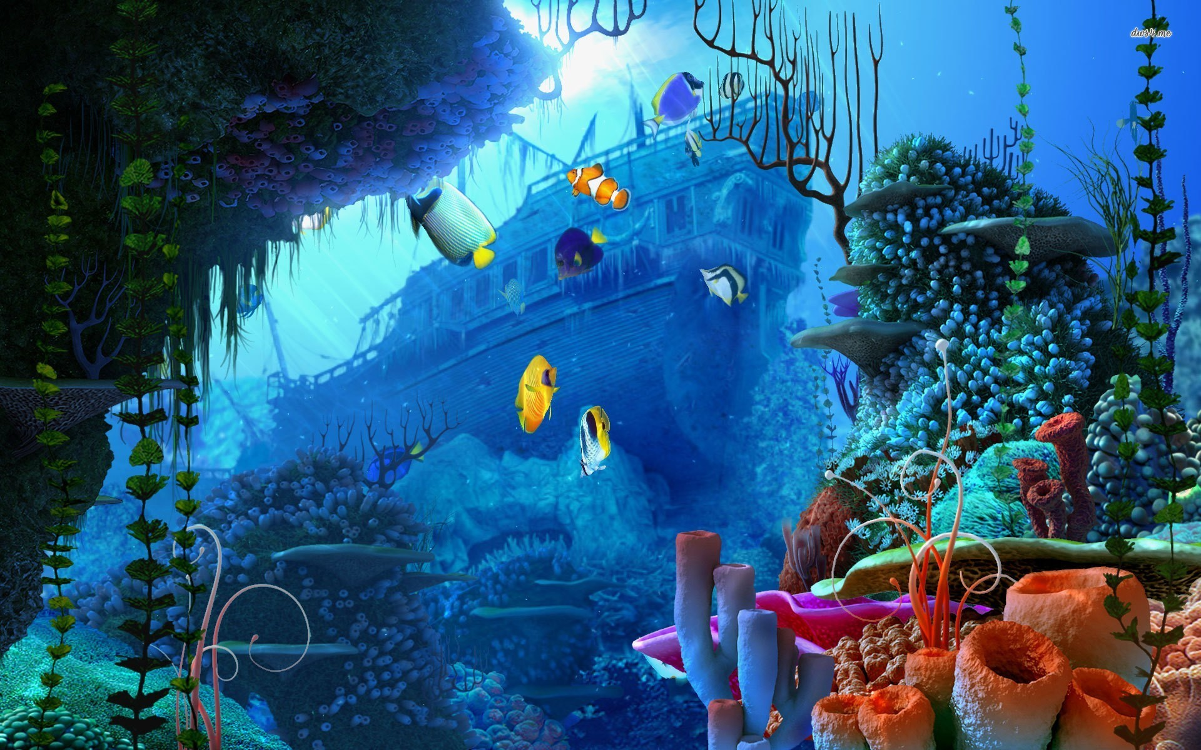

Slide 10

“Aki” - the Fish Daddy

Slide 11

“Koki” – the Little Fish

Slide 12



“Fuun” – The Thug Shark

Slide 13
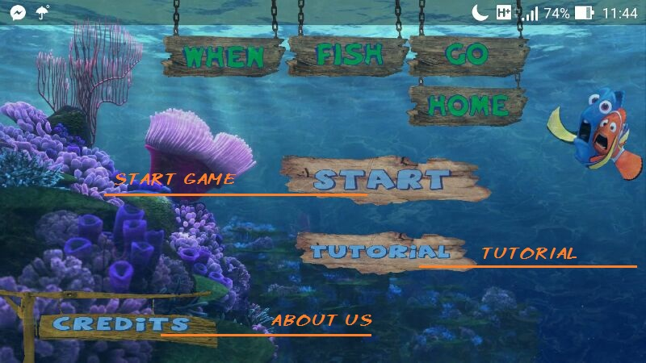
GAME SCENE & GAMEPLAY
Homescreen

Slide 14
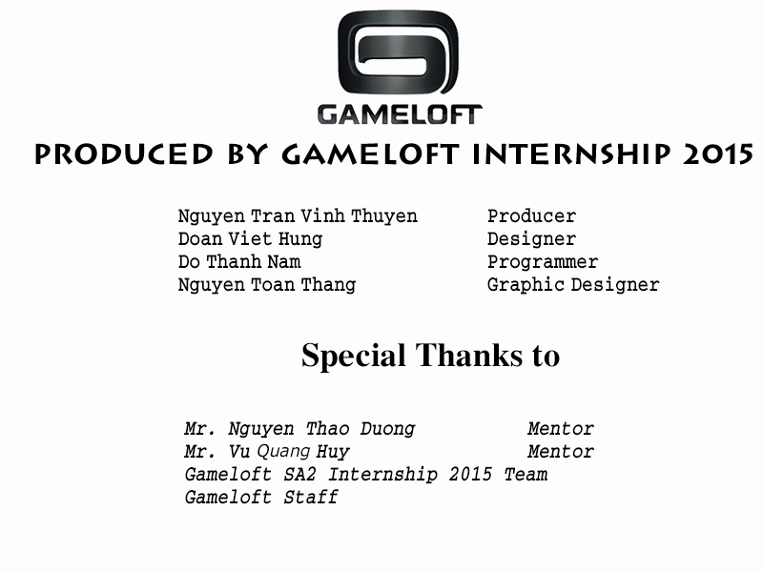
Credits

Slide 15
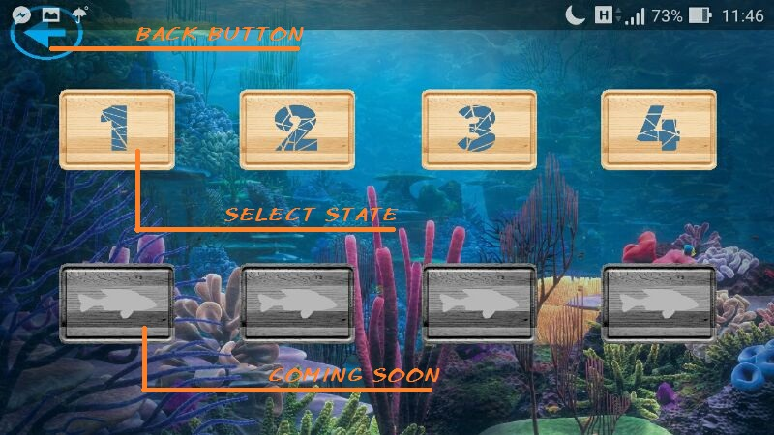
Stage Screen

Slide 16

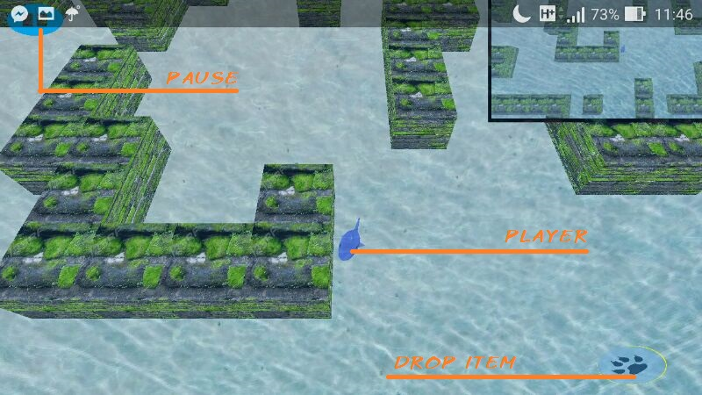
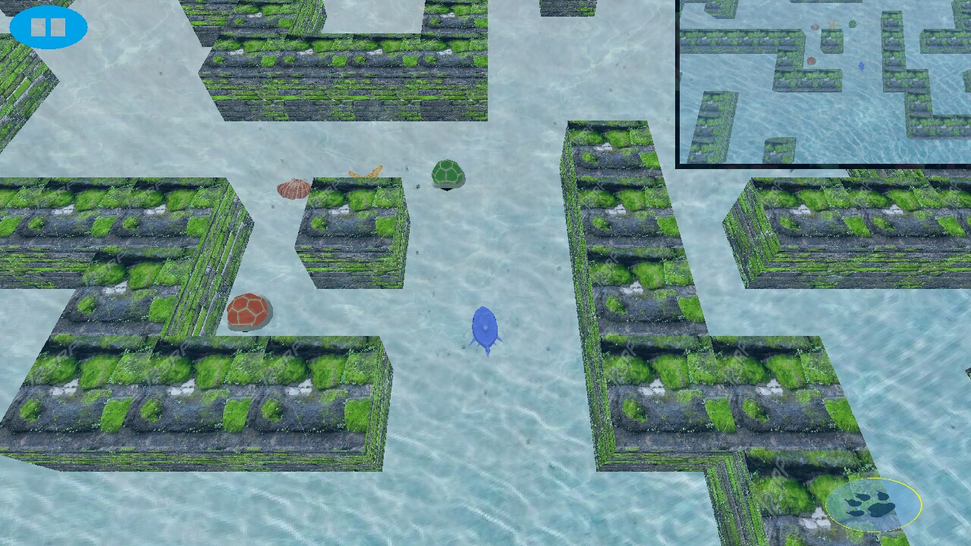
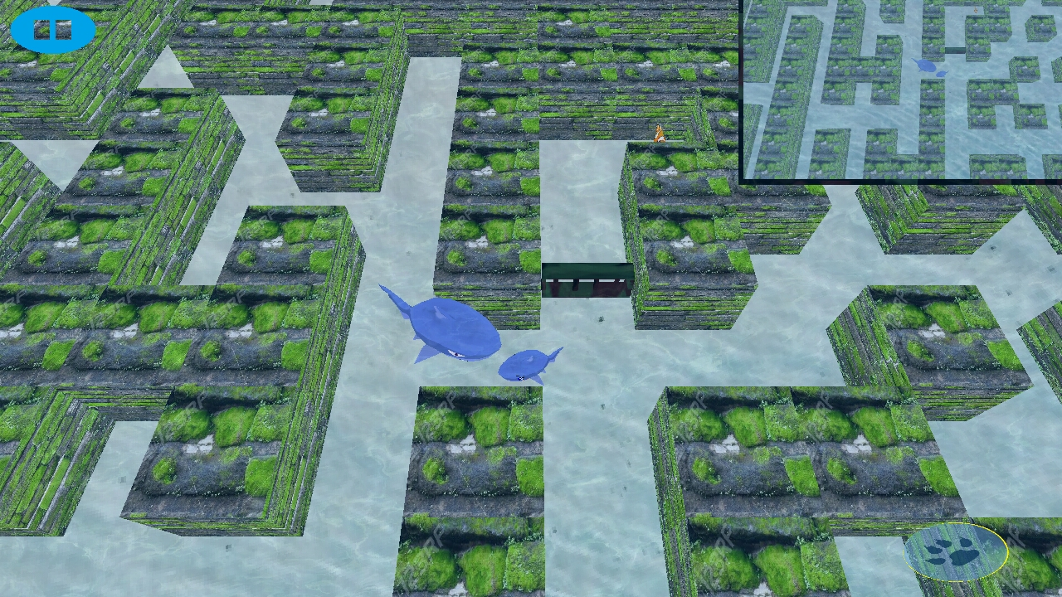

Slide 17
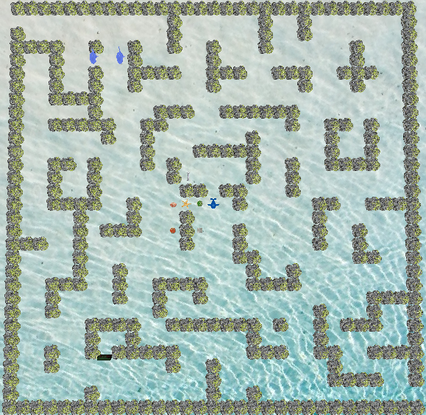

Slide 18


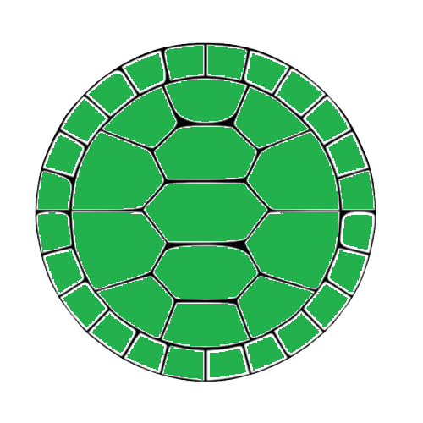

ITEMs
Slow Fuun
Mini-stun Fuun
Boost speed the Fishes
Stun Fuun

Slide 19

Revert control

Slide 20

Unlock the door

Slide 21
GRAPHICS & SOUNDS
Design Requirement
Fishes, Ocean, …
Background Sounds
Resources
Create by ourselves
Edit public resources
In-game resources
2D Model
Background sound
3D Model

Slide 22


Slide 23

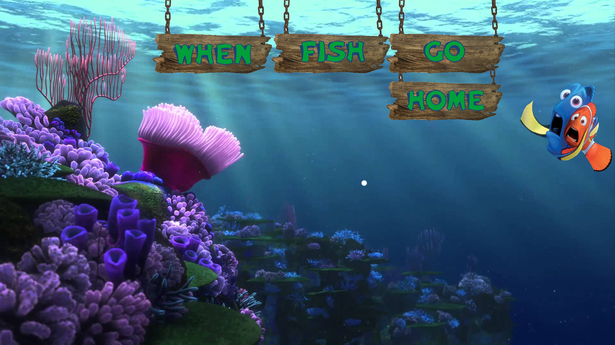



Slide 24
Final Resources
Quality
&
Art
Quantity
&
Time
Suitable
&
Sync

Slide 25
TECHNICAL

Slide 26

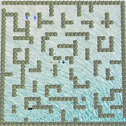
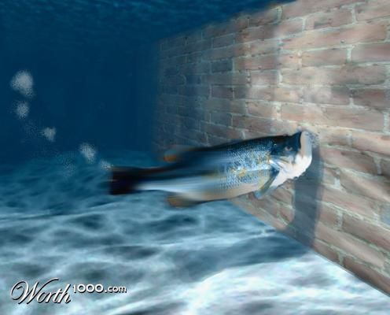



ARCHITECTURE DESIGN DESIGN
TERRAIN
COLLISION
AI
EFFECTS

Slide 27
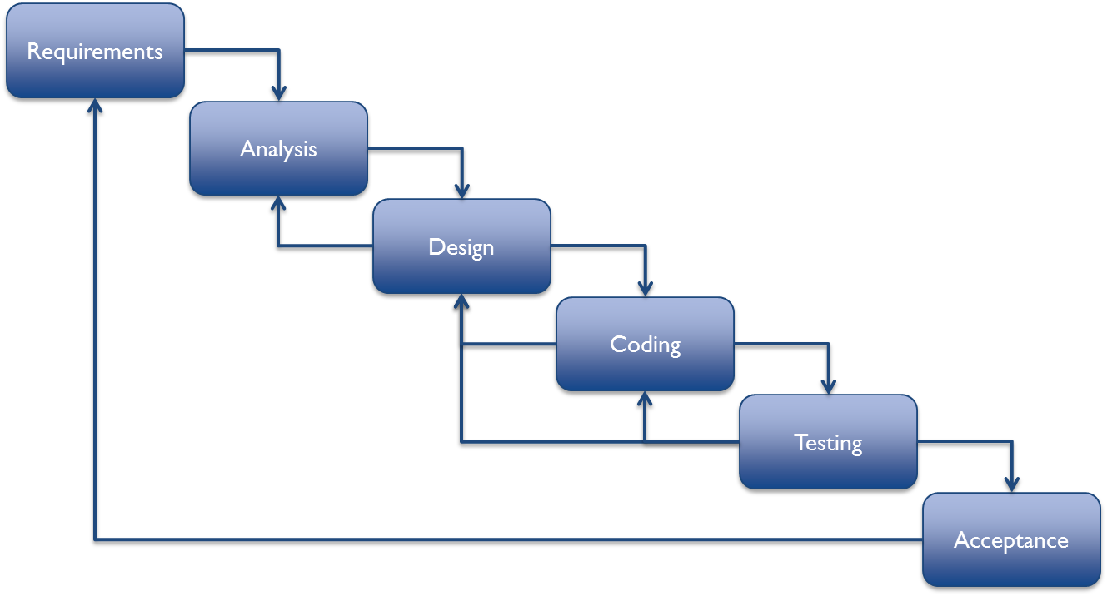
TECHNICAL ARCHITECTURE DESIGN
Software Process
Waterfall Model Improvements

Slide 28
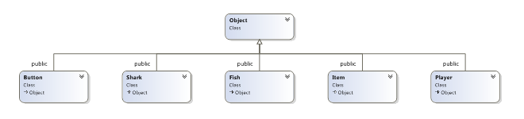
TECHNICAL ARCHITECTURE DESIGN
Game Architecture

Slide 29
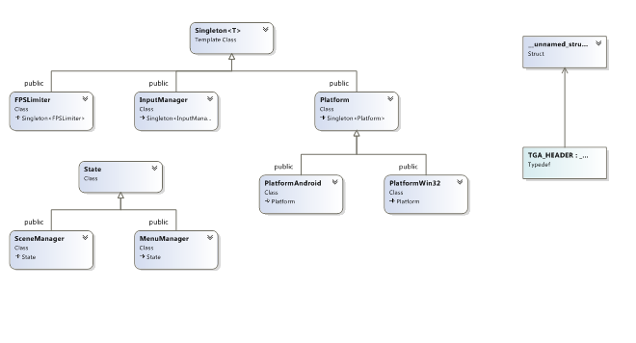

Slide 30
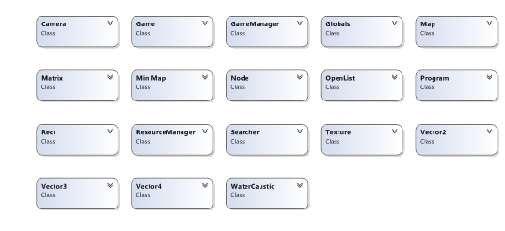

Slide 31
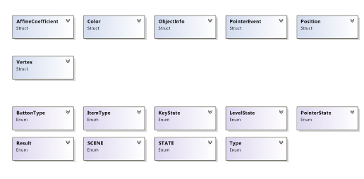

Slide 32


TECHNICAL ARCHITECTURE DESIGN
Design Pattern:
Creational:
Factory Method
Prototype
Singleton
Structural
Adapter
Decorator
Behavioral
Observer
State
Strategy

Slide 33
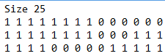
TECHNICAL TERRAIN
Create txt file
Generate Map

Slide 34
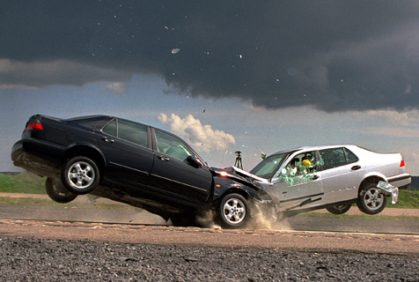
TECHNICAL COLLISION

Slide 35
TECHNICAL COLLISION
Each object has its own Collision Rectangle

Slide 36
TECHNICAL COLLISION
To detect collision
Using simple AABB algorithm

Slide 37


TECHNICAL ARTIFICIAL INTELLIGENCE

Slide 38
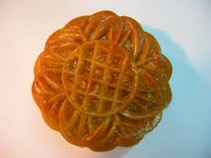
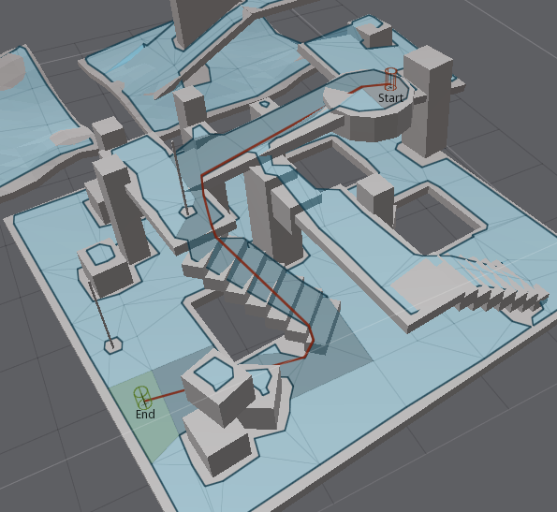

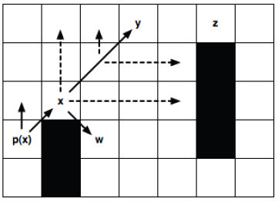
TECHNICAL ARTIFICIAL INTELLIGENCE

Slide 39
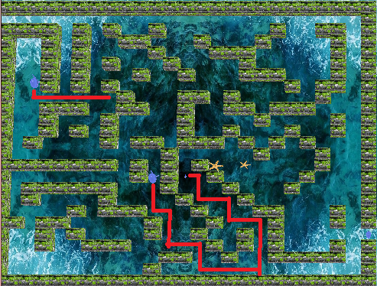
TECHNICAL ARTIFICIAL INTELLIGENCE
Jump Point Search

Slide 40


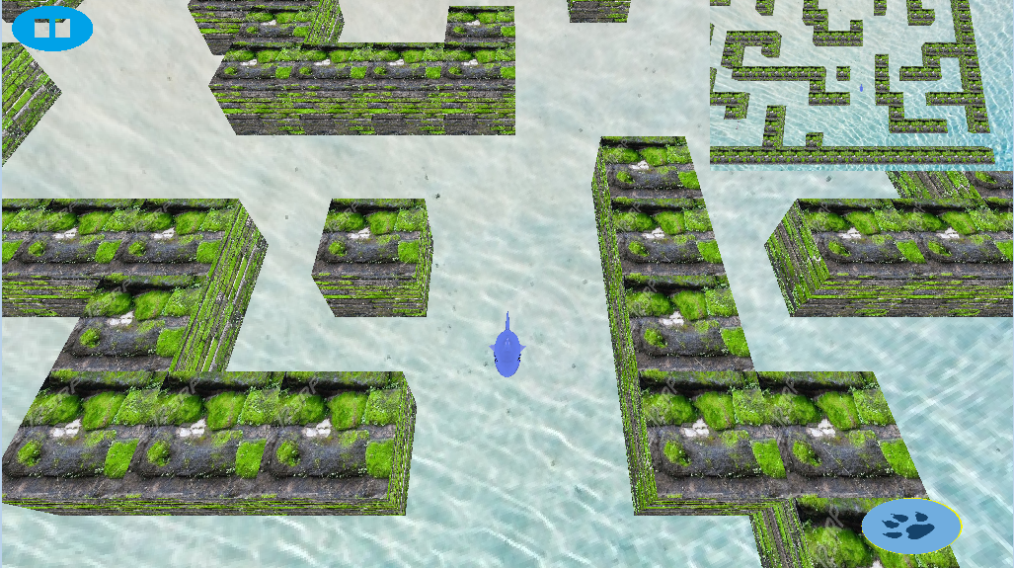
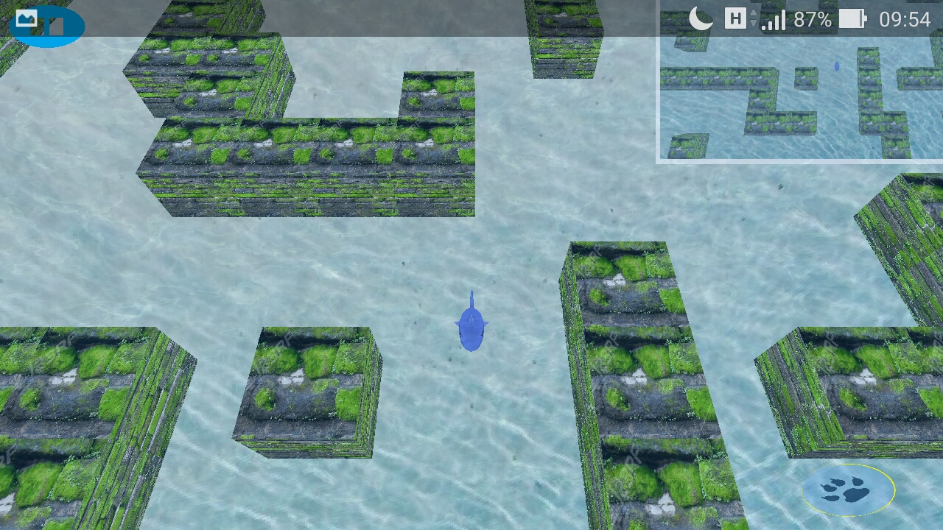
TECHNICAL EFFECT
Underwater Shader Effect

Slide 41


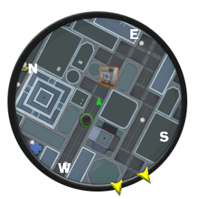
TECHNICAL Proplem
Performance

Slide 42
TECHNICAL OPTIMIZATION
Draw One Part

Slide 43


BUGs & FIXed
Bug ?

Slide 44
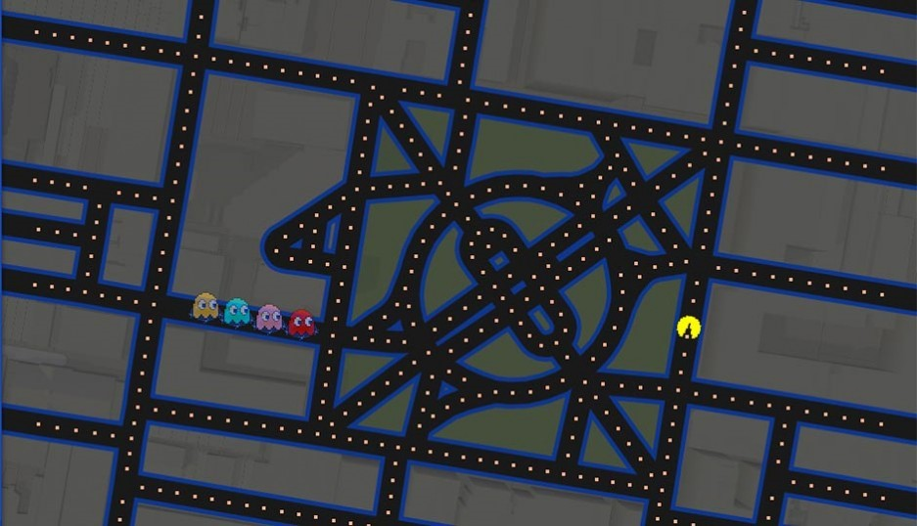
DEVELOPMENT STRATEGY

Slide 45
Thank you

